Slide 1
PET SITTER
MOHAMED ASHRAF ALI –
20BCE1630 SANJIL KC – 20BCE1855
LENIN VASAN – 20BCE1892

Slide 2
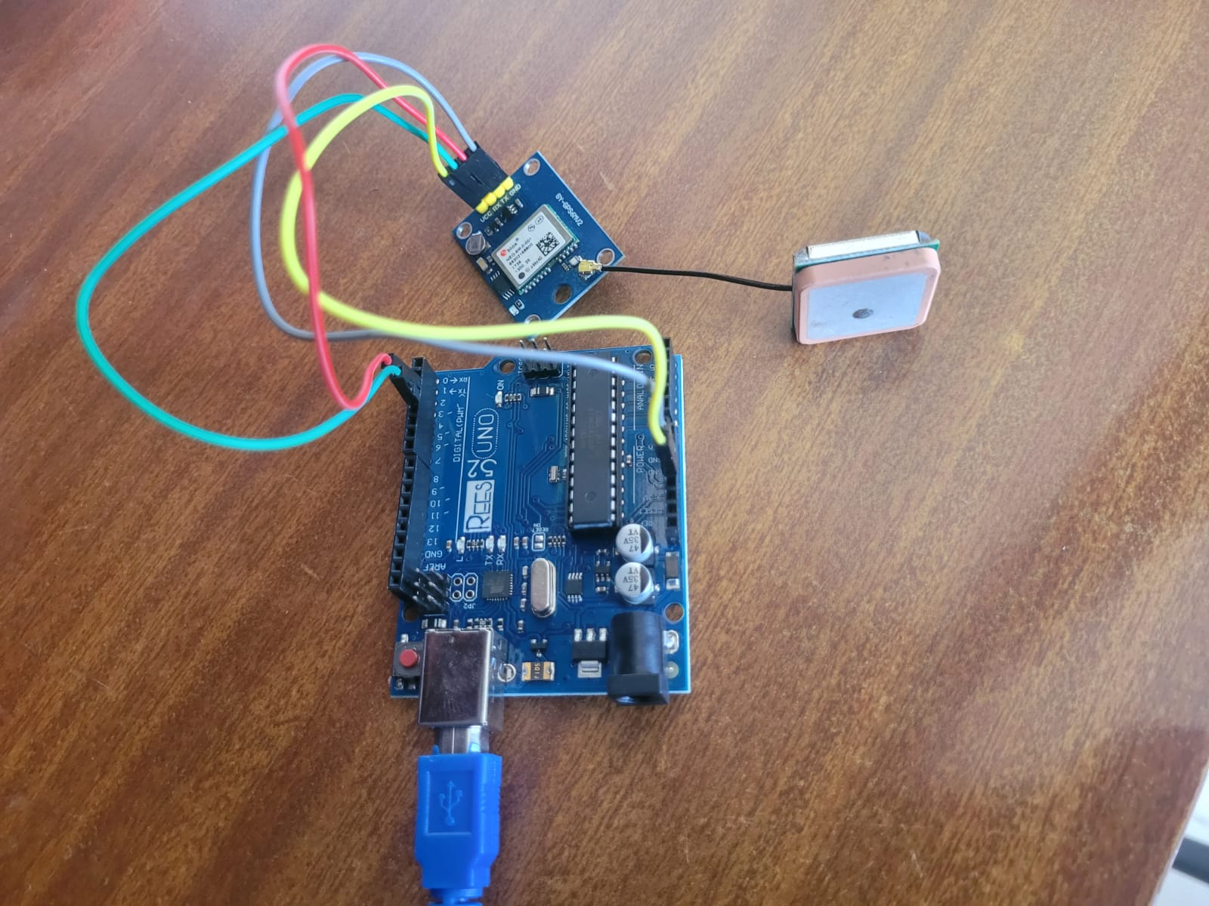
DEPLOYMENT - HARDWARE

Slide 3
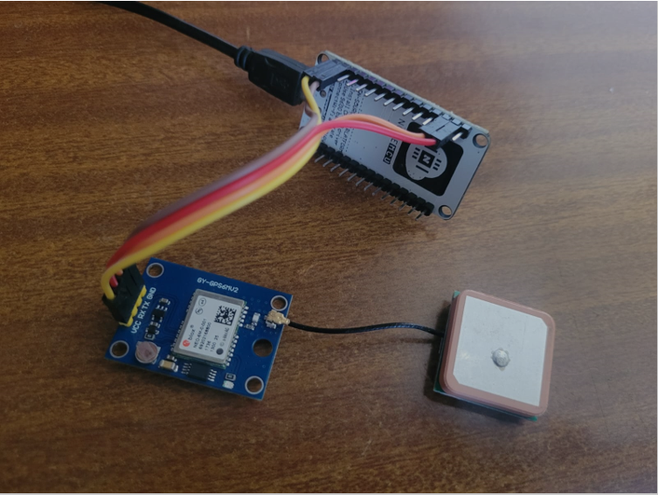
DEPLOYMENT - HARDWARE

Slide 4
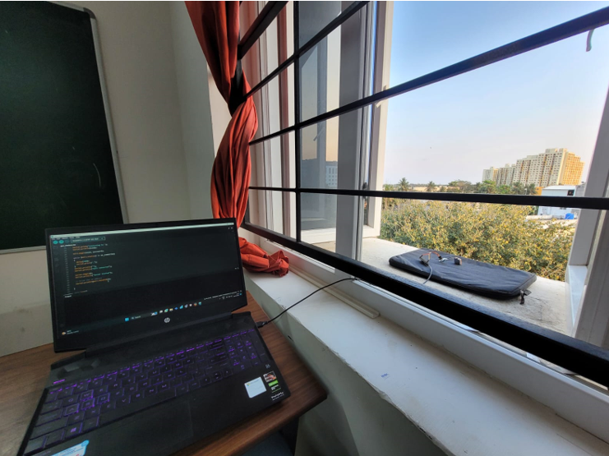
DEPLOYMENT - HARDWARE

Slide 5
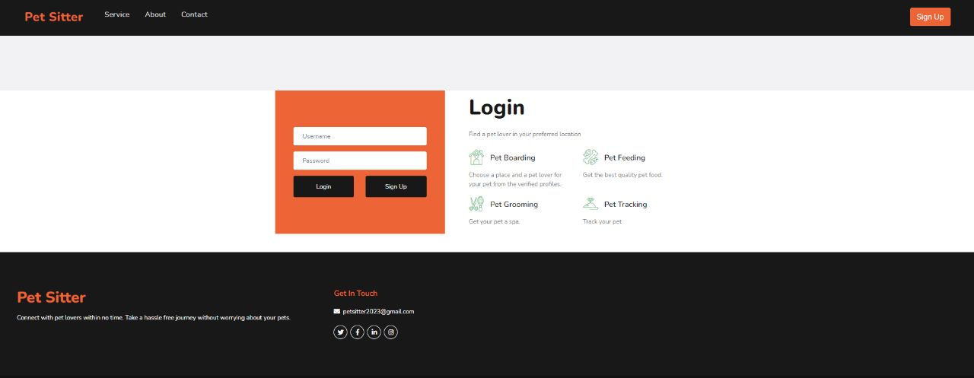
DEPLOYMENT – SOFTWARE WEB SITE
LOGIN PAGE:
On logging in as pet caretaker, the home page will have two options- view his/her profile and view booking made to him. The caretaker will also be able to view the about page of Pet Sitter.

Slide 6
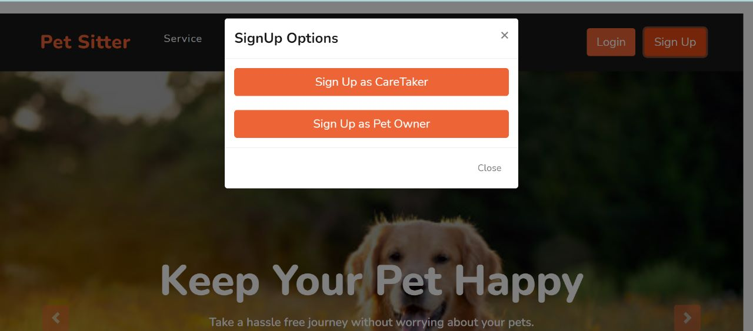
On visiting the website, the home page will be rendered displaying what Pet Sitter is all about. This page will have separate buttons to login and signup as pet owner or as pet caretaker.
SIGN UP PAGE:

Slide 7
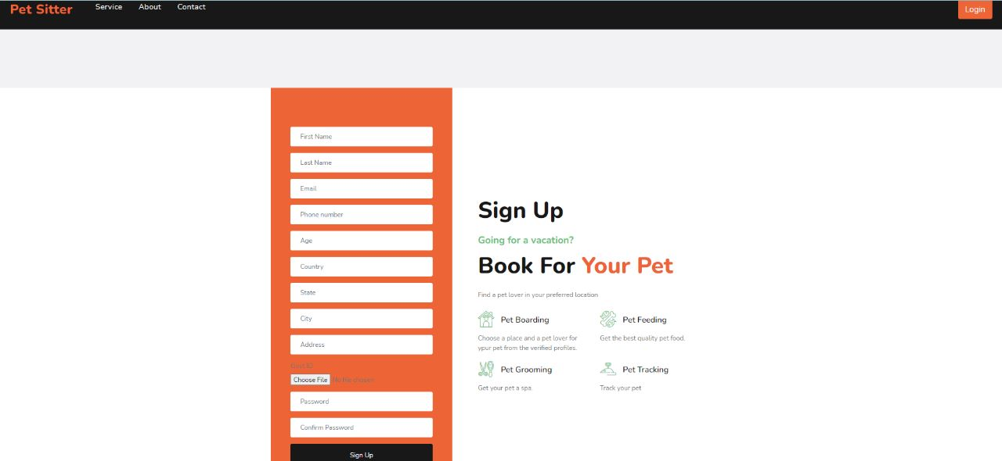
Sign up as Pet Owner-
Once signed in as pet owner, he/she will have options to view his/her profile, view the about page of WOOF, view the previous bookings and view the services offered by WOOF.

Slide 8
HARDWARE OUTPUT
1.Connect the circuit as shown in the schematic.
2.Upload the code after changing ssid and password.
3.Open serial monitor in Arduino IDE and note down IP address of the
web server.
4.Open any Browser and enter the IP address of the webserver.
5.It will display Location details, date, time and Google maps link.

Slide 9
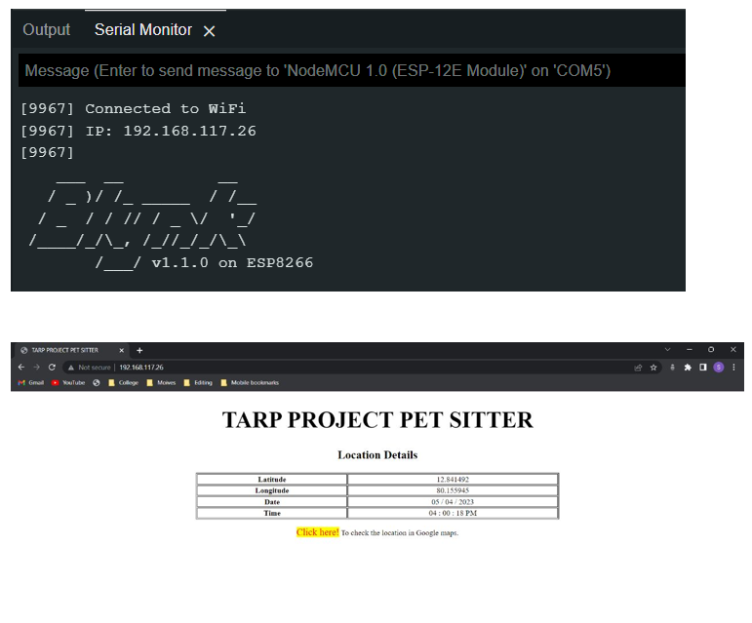
RESULT

Slide 10
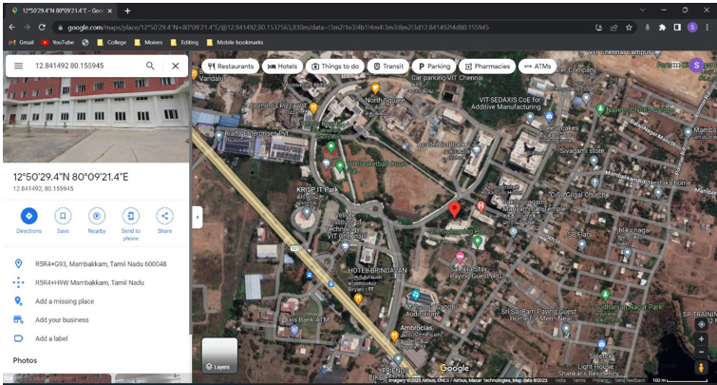
RESULT

Slide 11
THANK YOU

